Slide 1
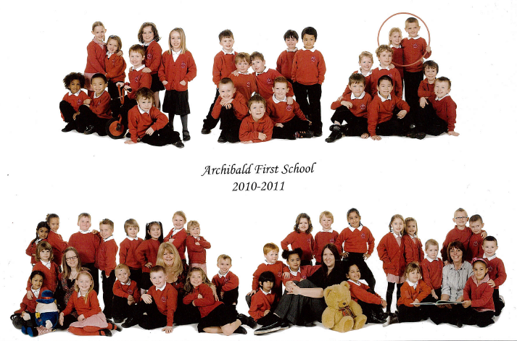
Leavers Assembly 2015

Slide 2
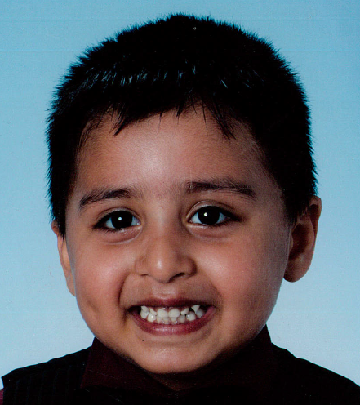
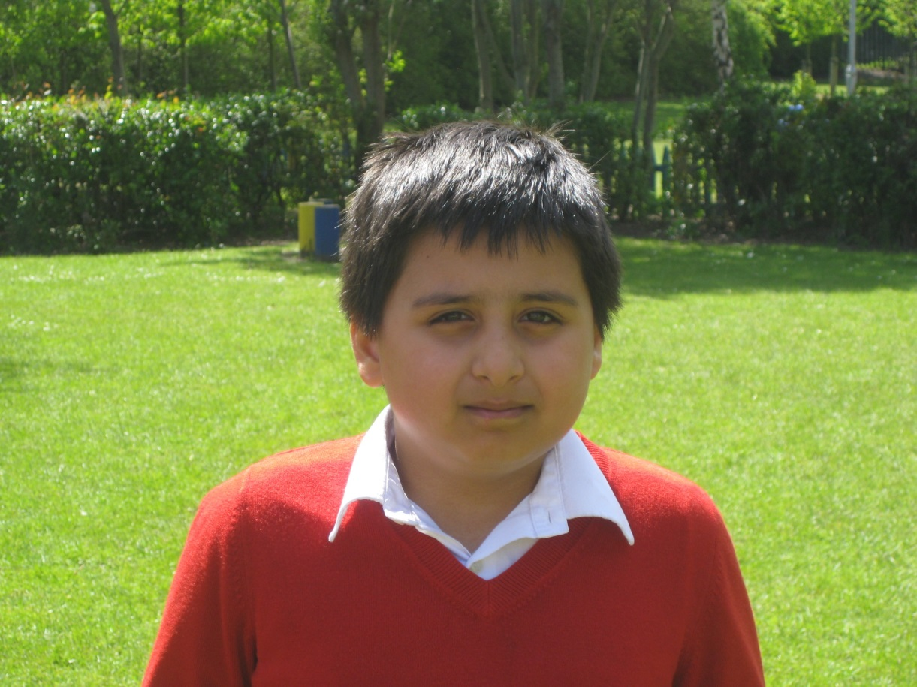

Slide 3
MY favourite memory of Archibald
Is when we did a picnic in the play ground with all our friends

Slide 4
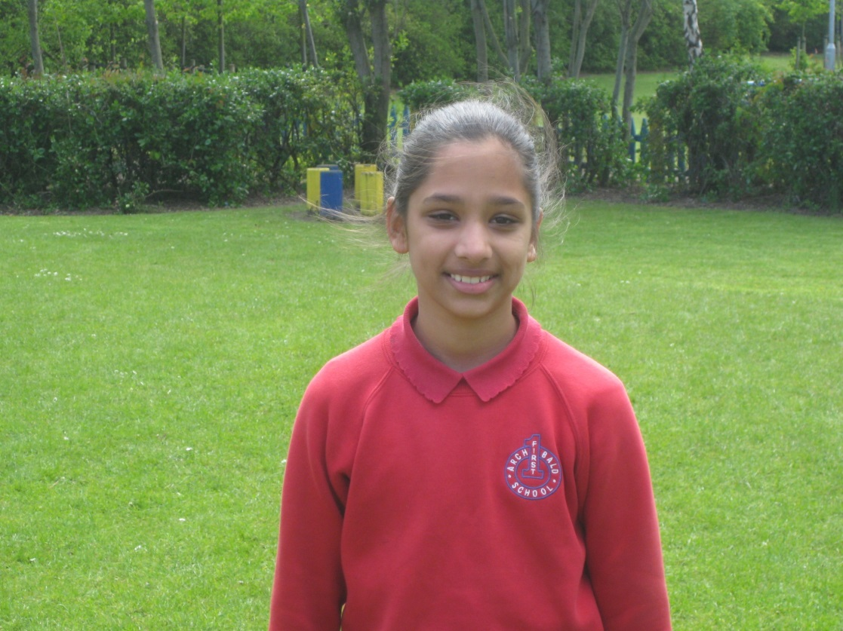

Slide 5
My favourite memory of Archibald
My favorite memory was when I went to the centre for life I really liked going to the 4D motion ride.
I remember when I met the teachers and made new friends.
Harleen

Slide 6
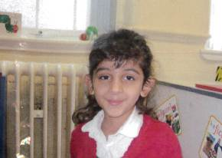
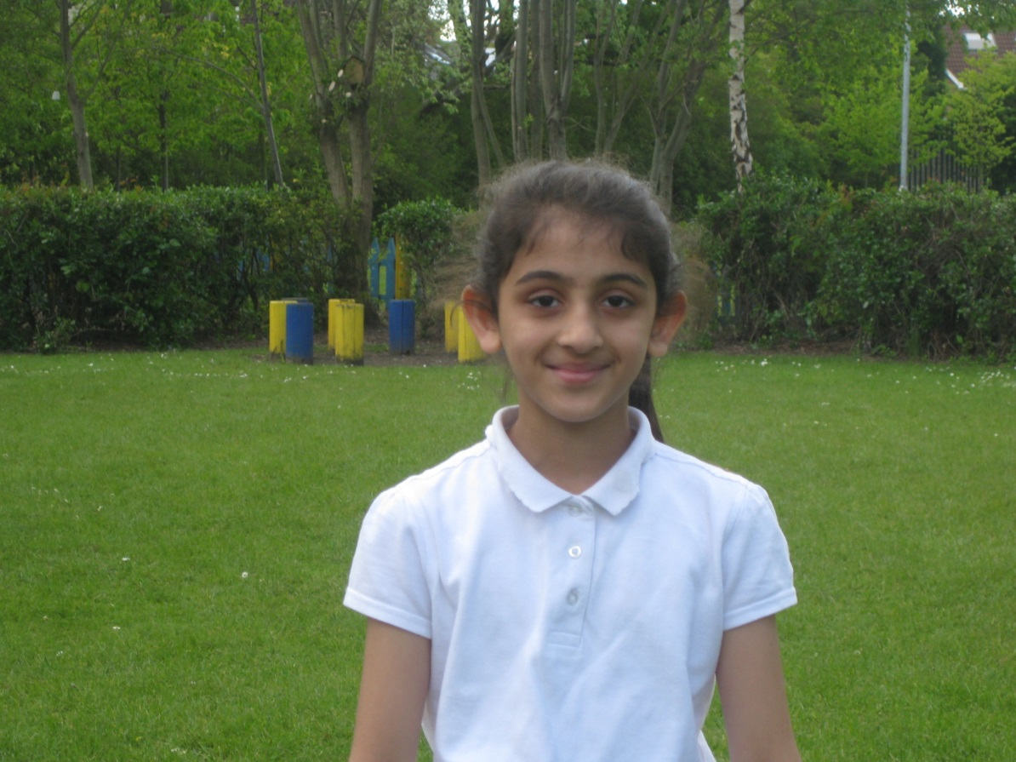

Slide 7
My favourite memory of Archibald is…
When I played with my friends because it was fun. Another time is when I did art in nursery because we had stickers

Slide 8
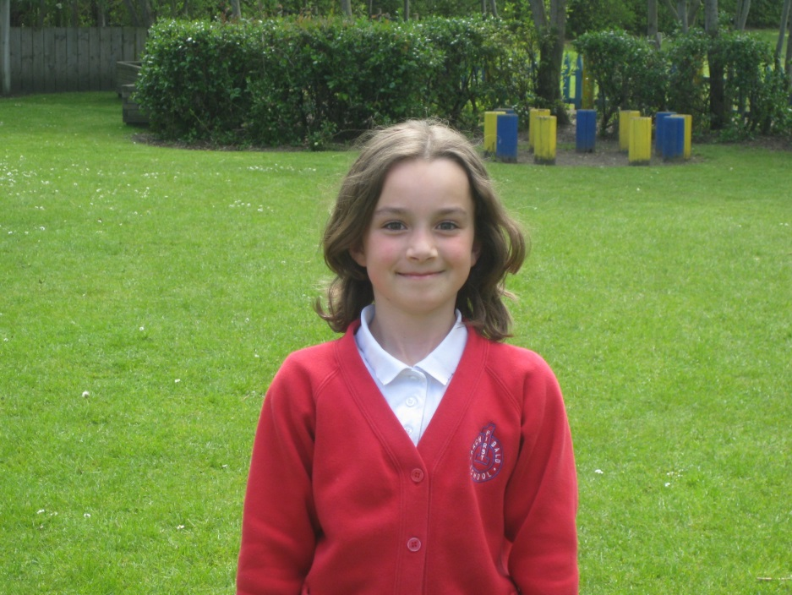
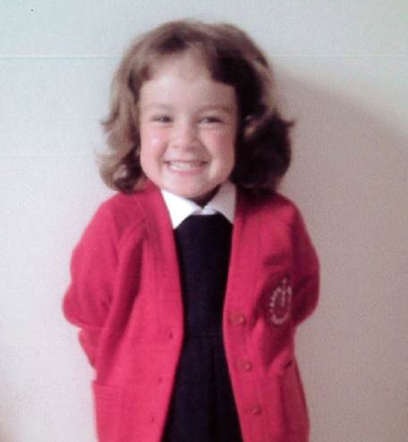

Slide 9
My favourite memory of archibald
My favourite memory of Archibald was when it was my birthday on a disco day!
Chloe

Slide 10
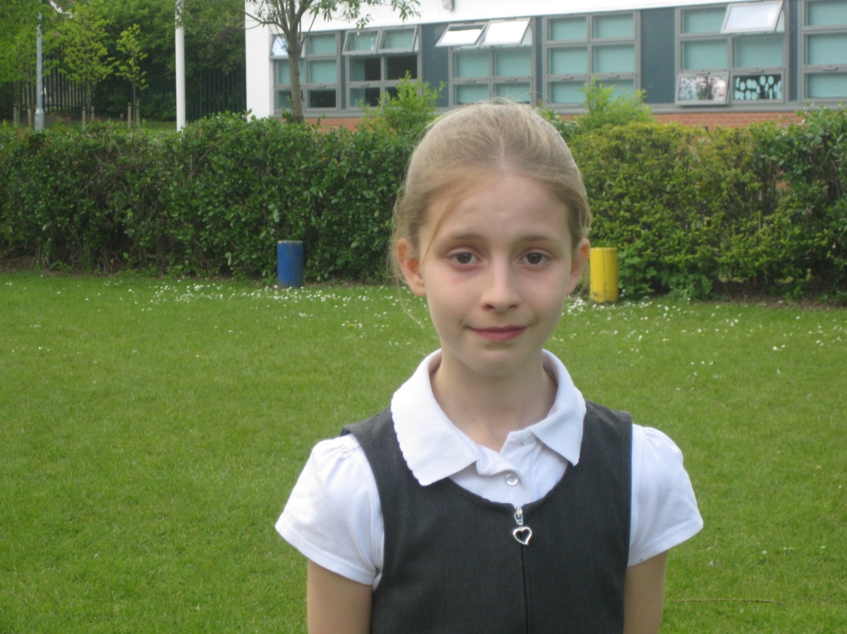

Slide 11
My favourite memory of archibald .
My favourite memory is at playtimes when I make my friends laugh.

Slide 12
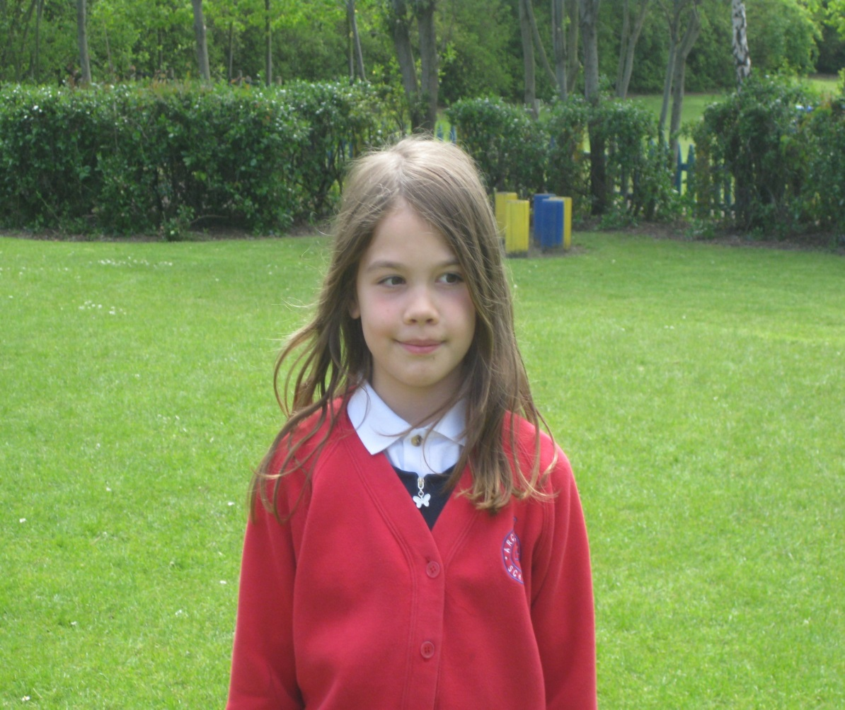
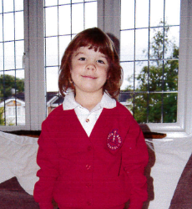

Slide 13
My favourite Memory of Archibald
My favourite Memory of Archibald was when I was making patterns in melted chocolate with my friend Maisie in Reception.

Slide 14
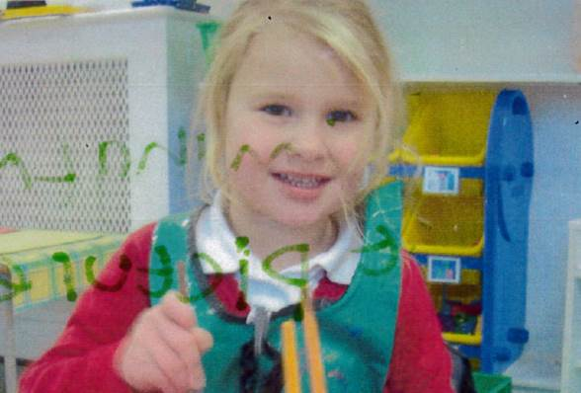
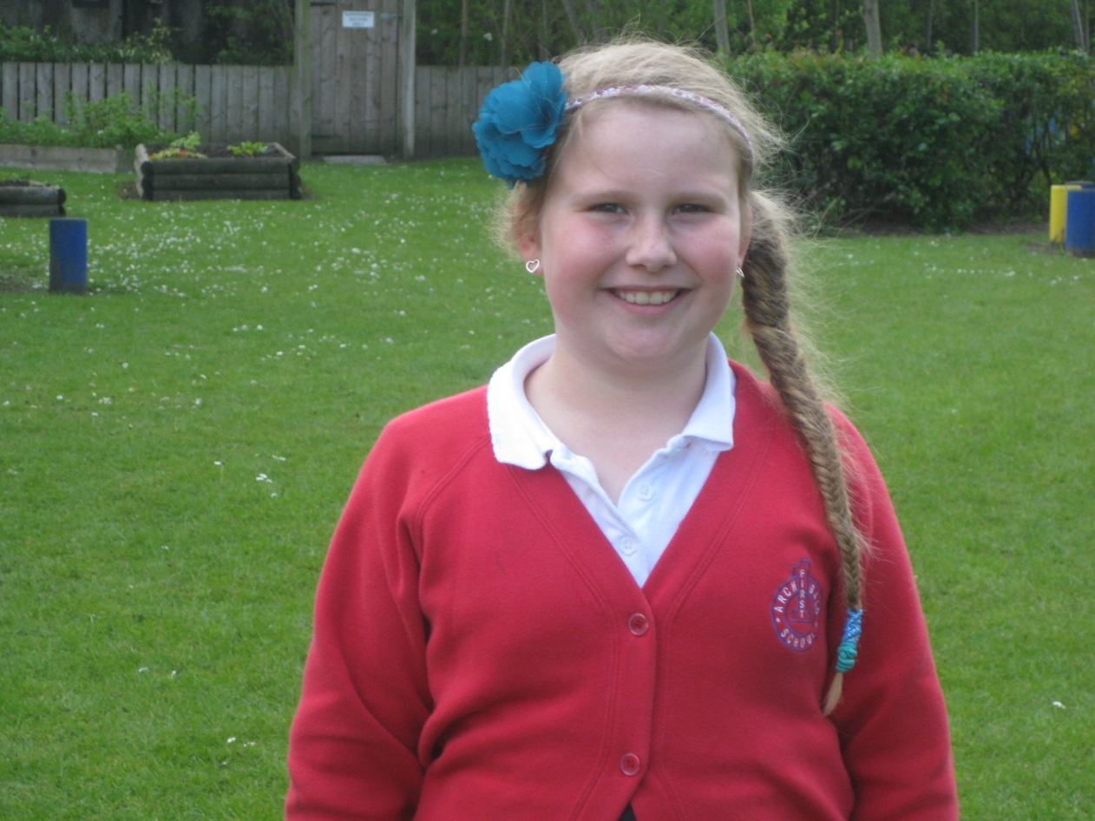

Slide 15
My favourite memory of Archibald
My favourite memory is when I was I year 3 and I had the scissors in my hand an I turned around the I chopped some of my hair off and Mrs Turner had to go and see my mum.

Slide 16
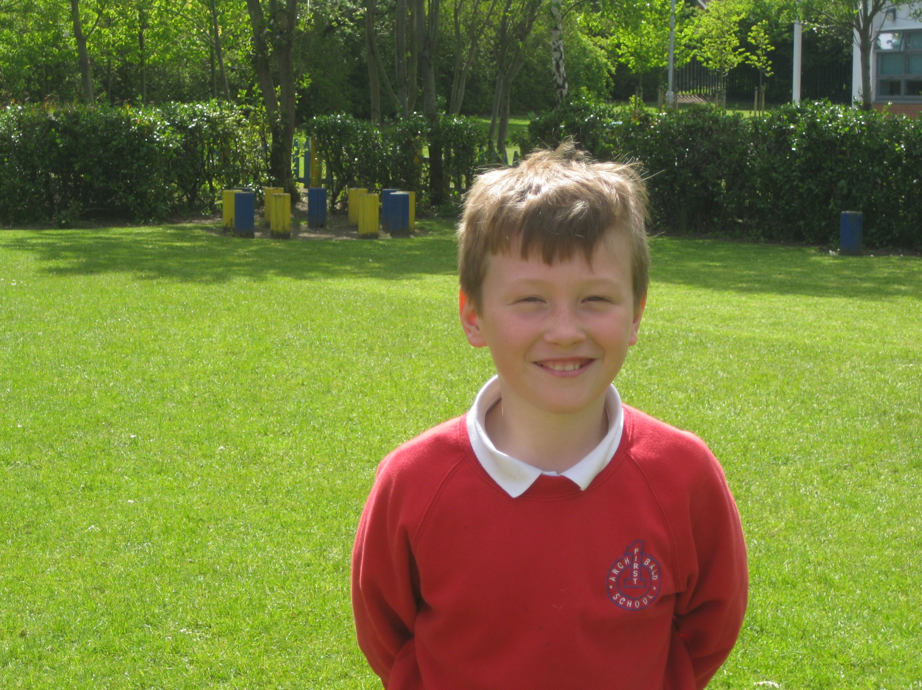

Slide 17
My favourite memory of archibald
My favourite memory
of Archibald is the trip to Tynemouth aquarium because I learned so much.

Slide 18
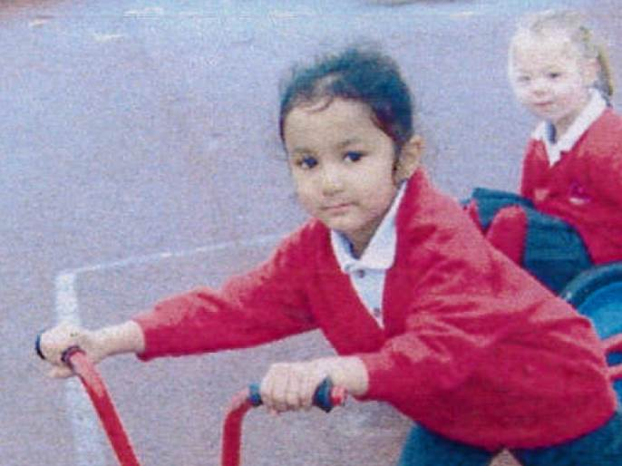
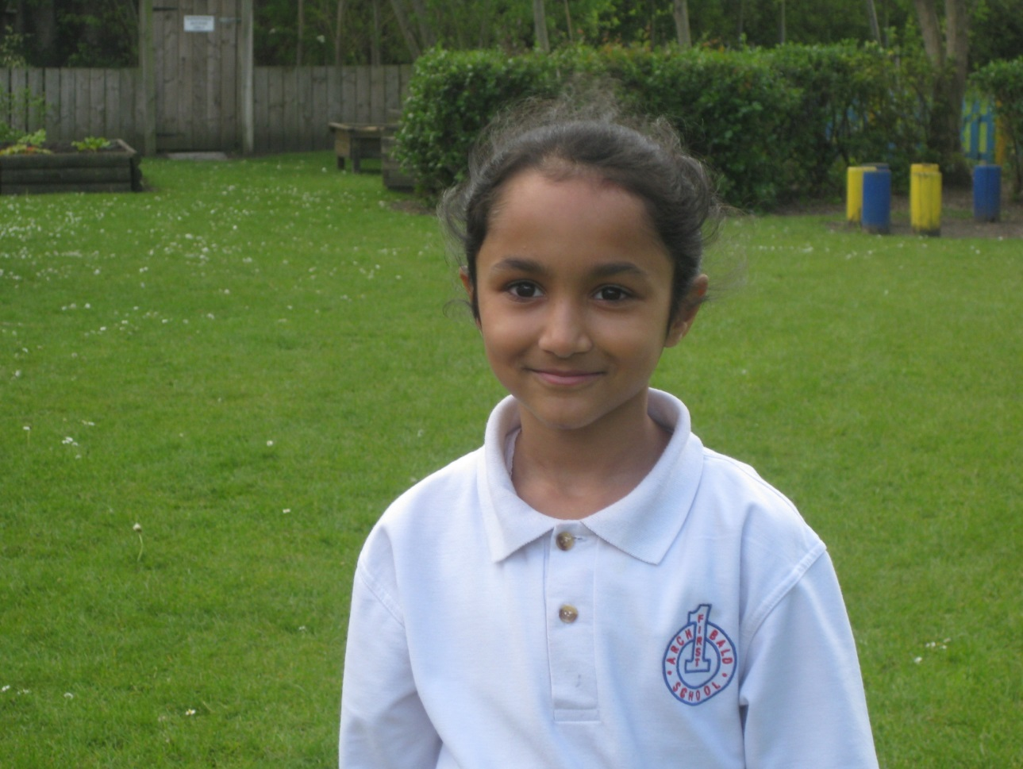

Slide 19
My favourite memory of Archibald
Was when I went to white house farm in reception. I had a lot of fun with my friends. My favourite part was petting the animals .

Slide 20
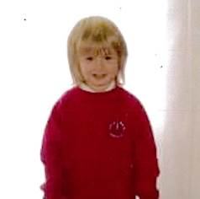
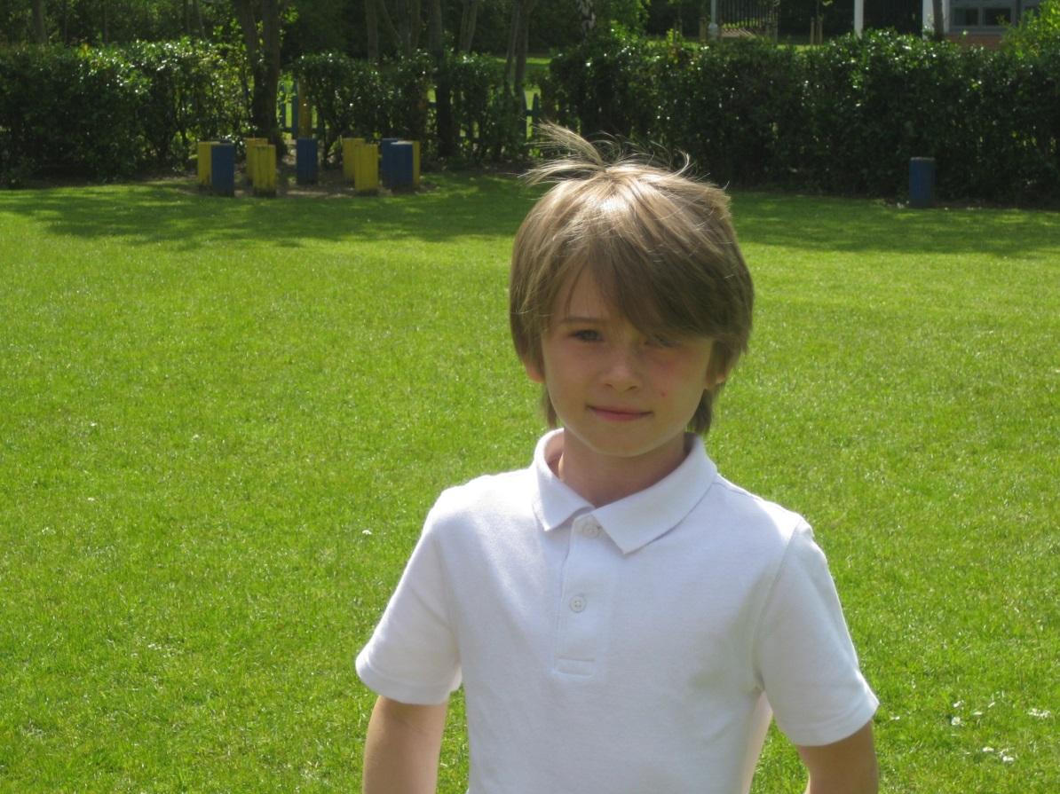

Slide 21
My favourite memory of Archibald
My favourite memory is when I went to Hawkhirst.
Theo

Slide 22
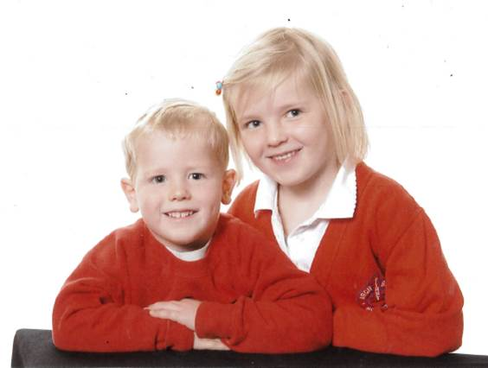
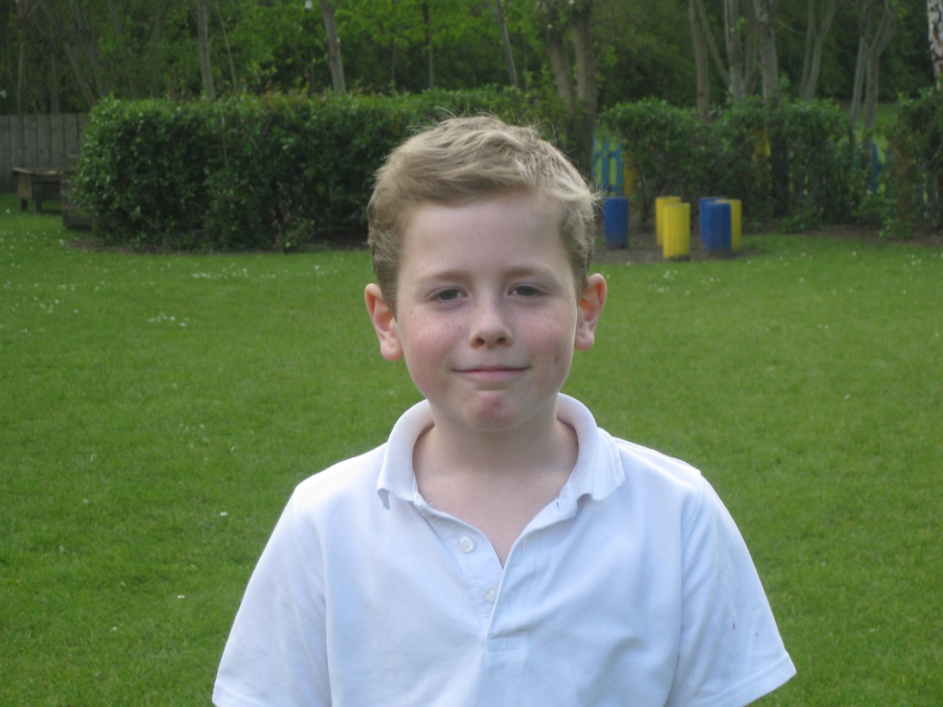
Angus

Slide 23
My favourite memory of Archibald
When I was doing recycling and the bin bag split and everything flew onto Mr McDermott's floor!!!!

Slide 24
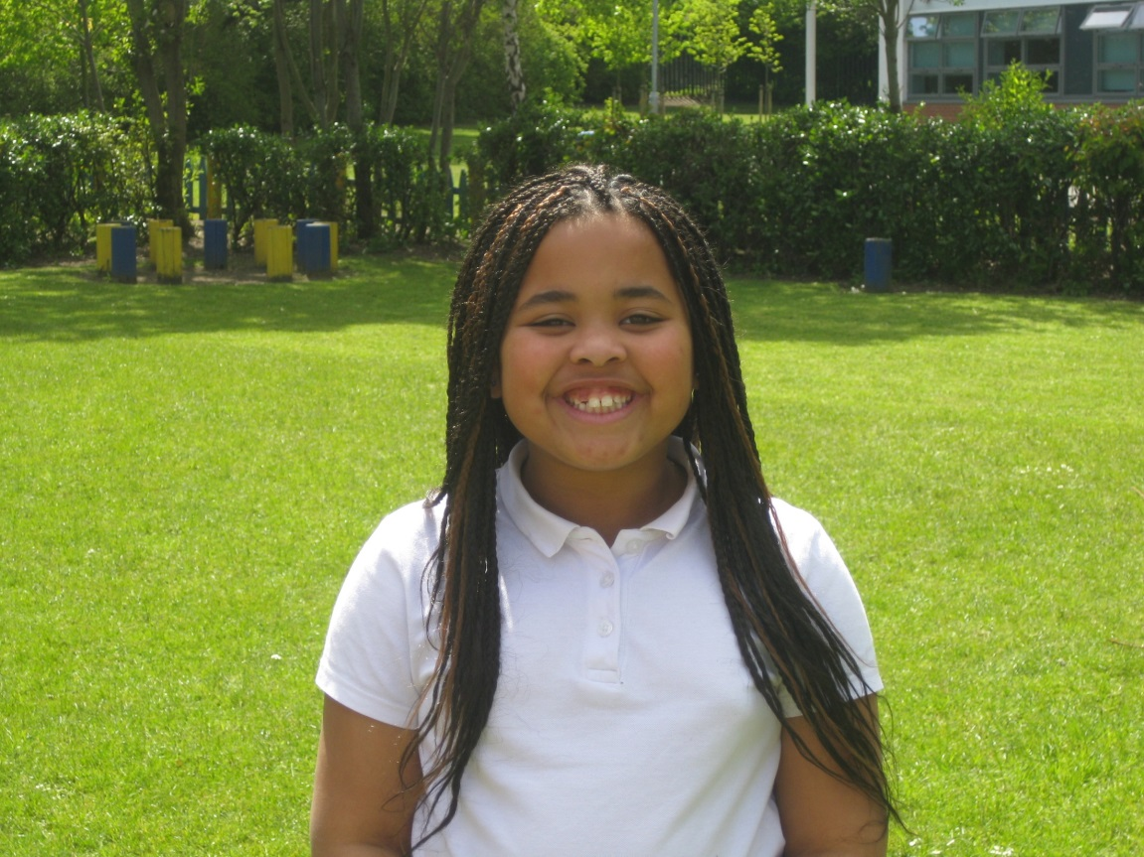
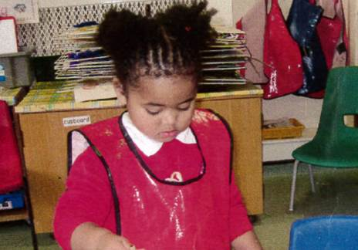

Slide 25
My favourite memory of Archibald
Going to the beamish trip it was great fun if I was offered to go I would go again

Slide 26
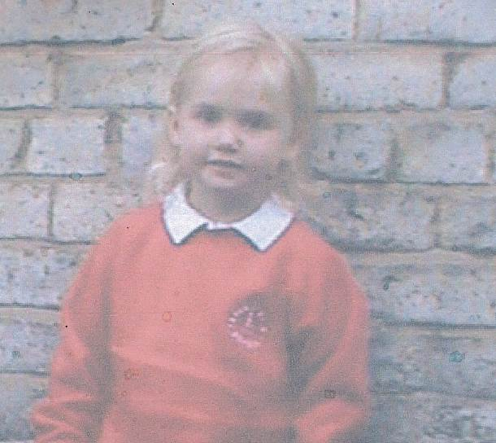
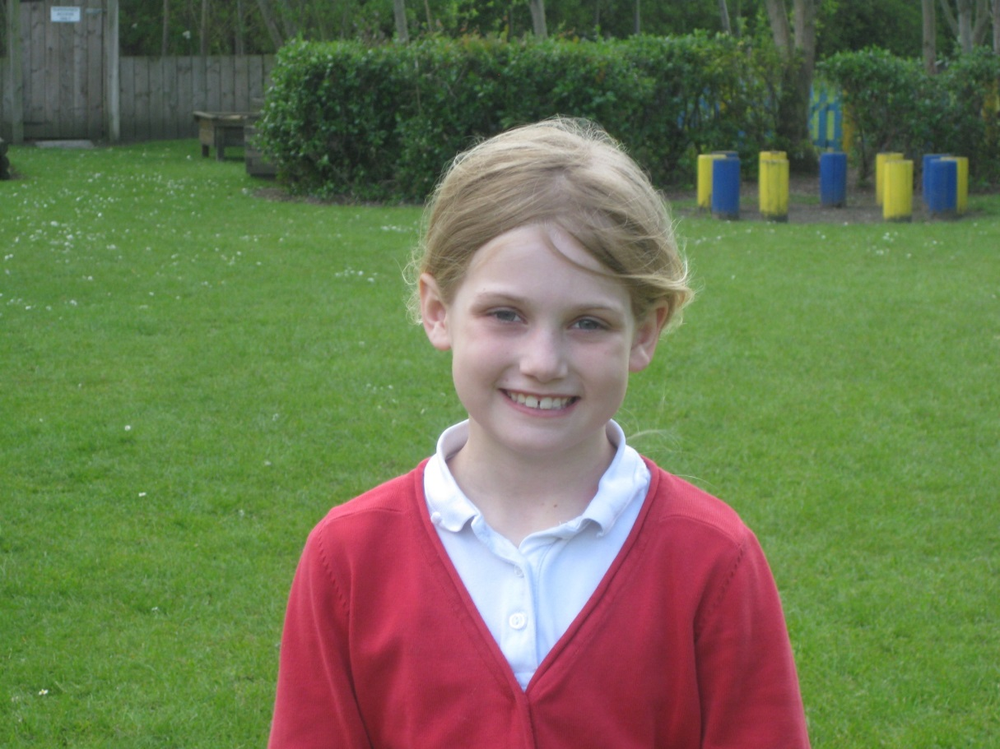

Slide 27
My favourite memory of Archibald
Is pretending to be a head chopping prince in the play!!!!

Slide 28
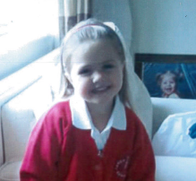
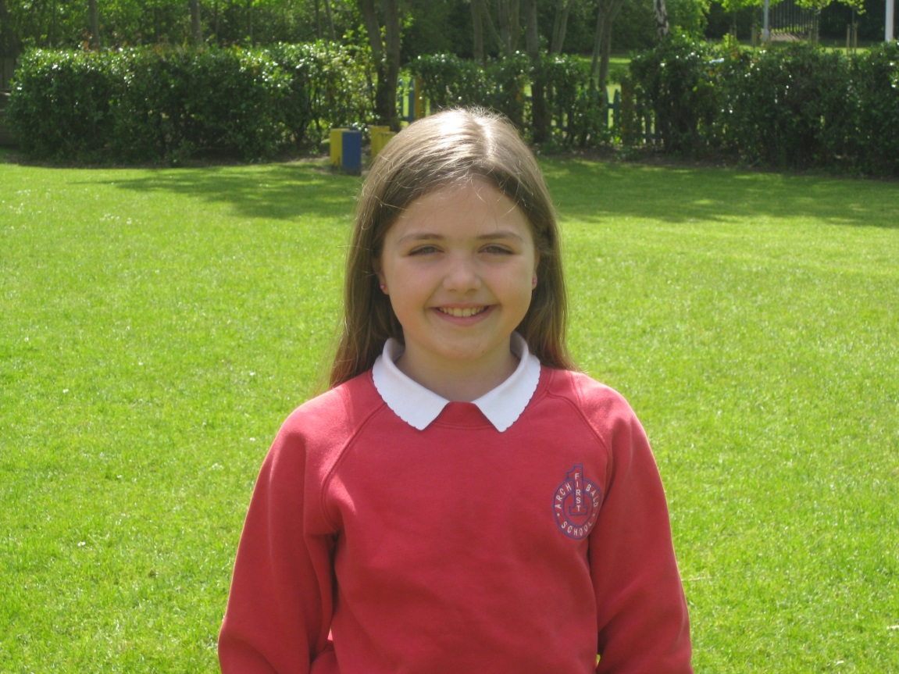

Slide 29
My favourite memory of archibald
Was my friends, my teachers and Hawkhirst.

Slide 30
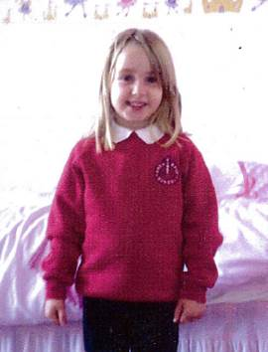
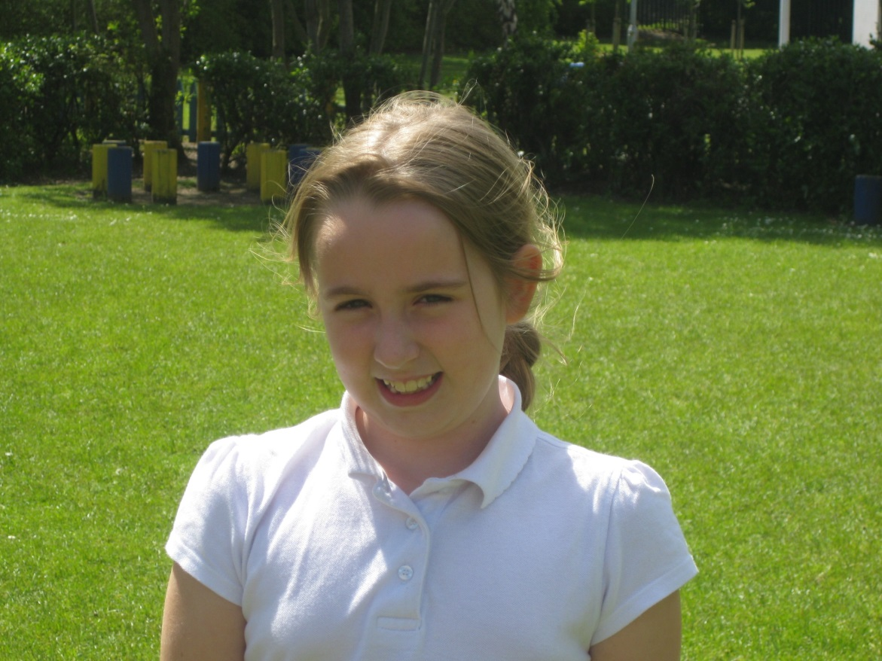

Slide 31
My Favourite memory of Archibald
Is when Mrs Dawson sings in the classroom because it is so funny.

Slide 32
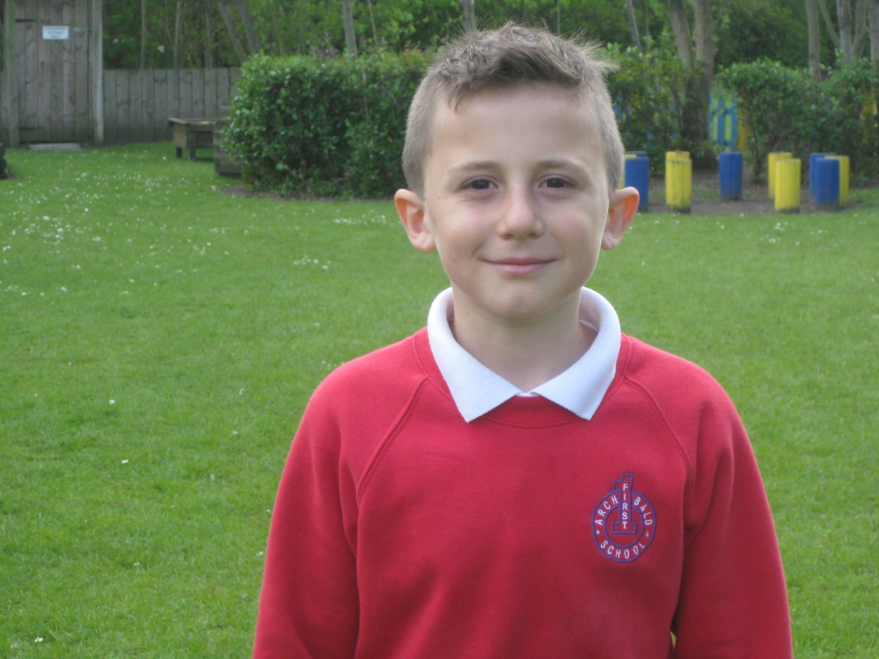

Slide 33
My favourite memory of Archibald
Was when we went to Hawkhirst to do all the activities and it was fun when we did a night show!!

Slide 34
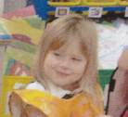
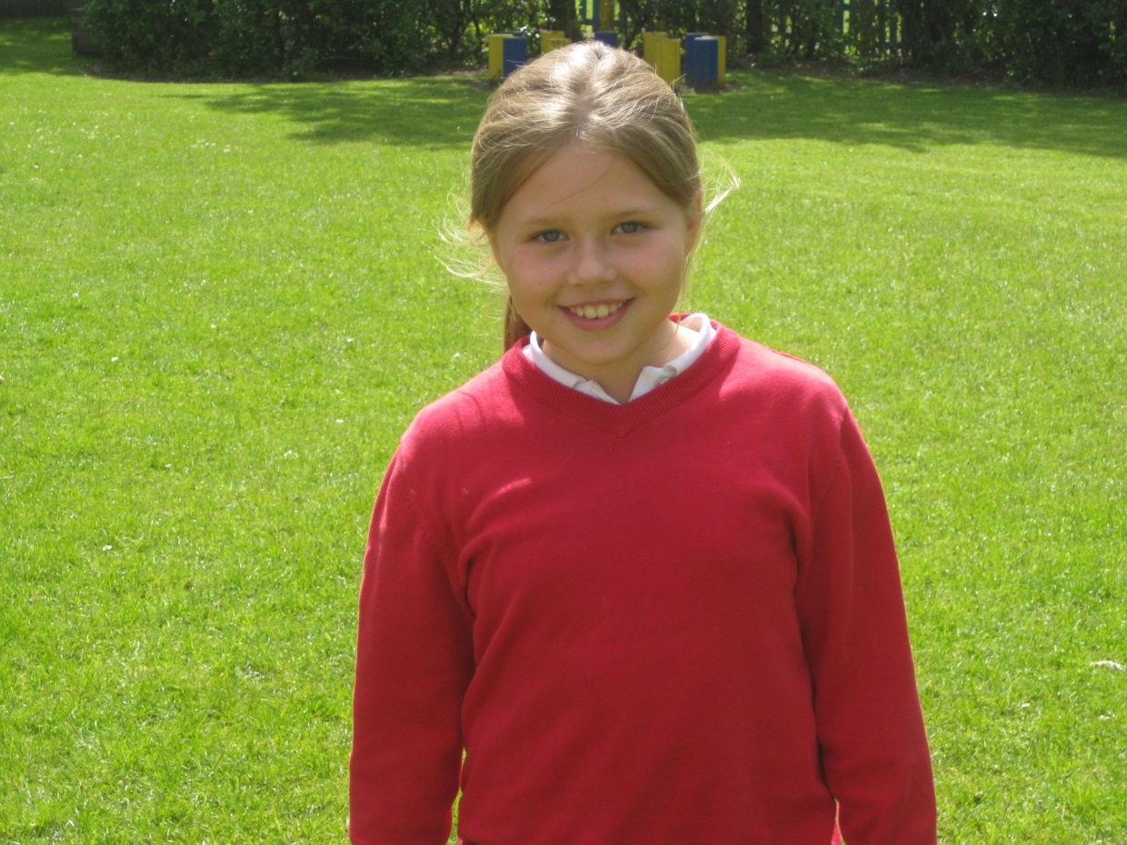

Slide 35
My Favourite memory of Archibald
My favourite memory of Archibald was when I had new friends and when they put a smile on my face.

Slide 36
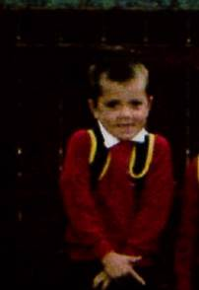
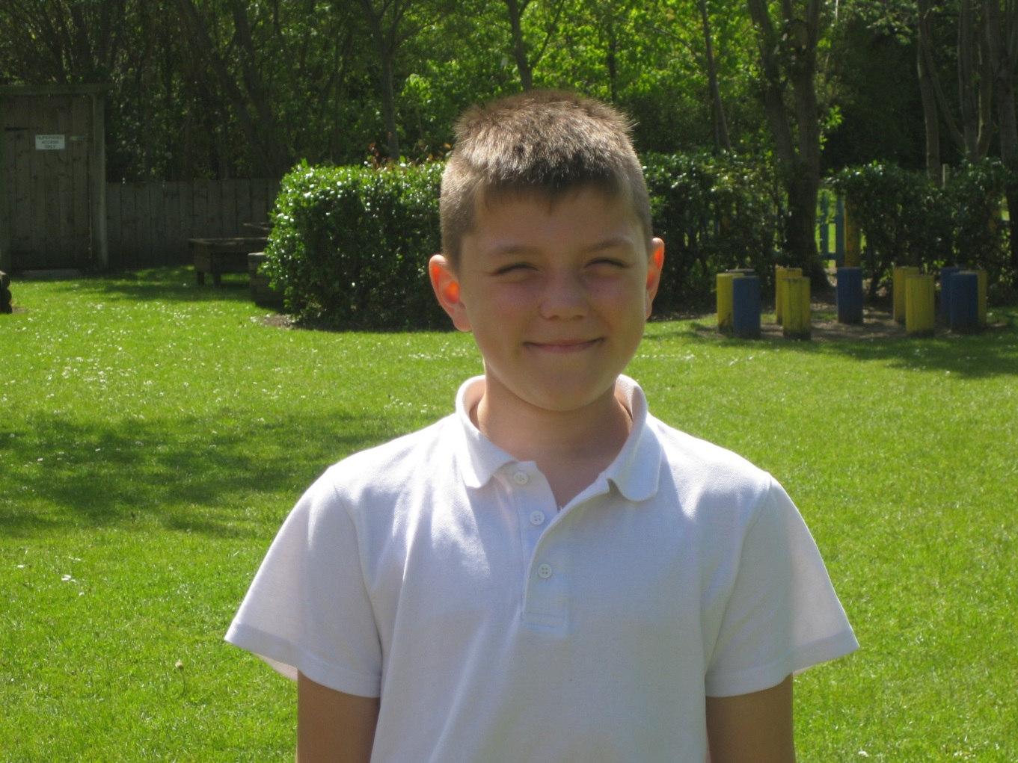

Slide 37
my favourite memory of Archibald.
My favourite memory is playing with my friends on the slide
And I liked playing with the toys in nursery.

Slide 38
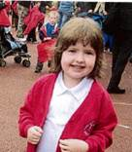
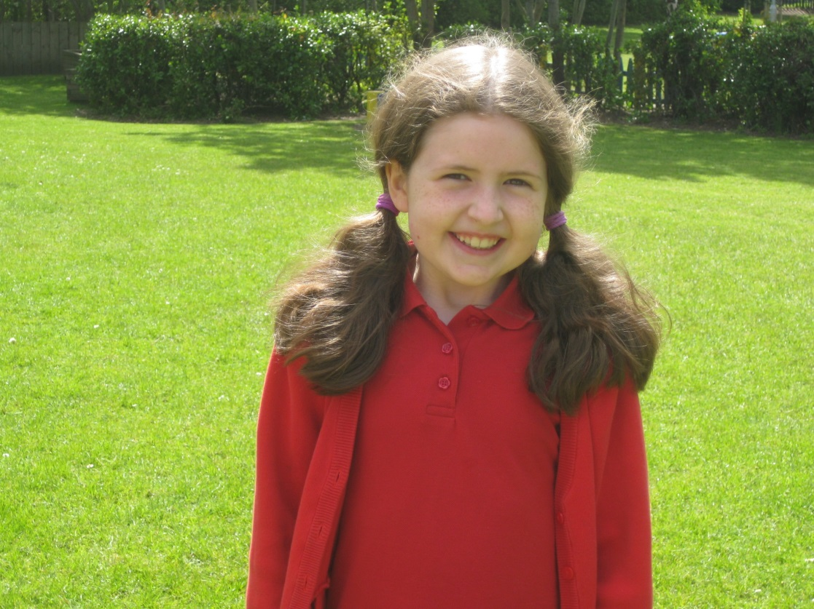

Slide 39
My favourite memory of Archibald
Was chess club with Mr McDermott !!!!!!!

Slide 40
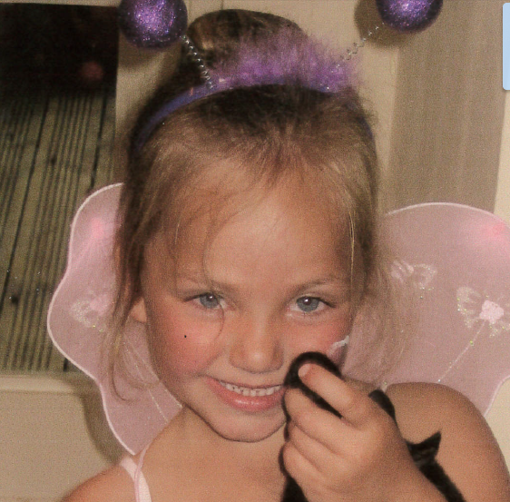
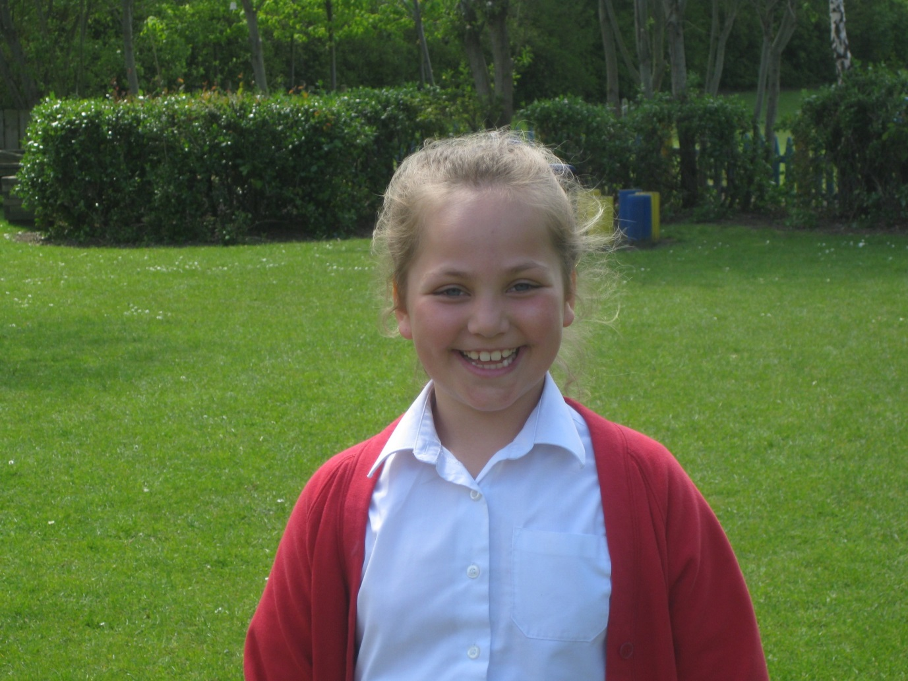

Slide 41
My favourite memory of Archibald
I like it when Mrs Dawson tells us about Bronwyn because it reminds me of when I was little.

Slide 42
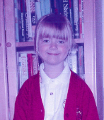
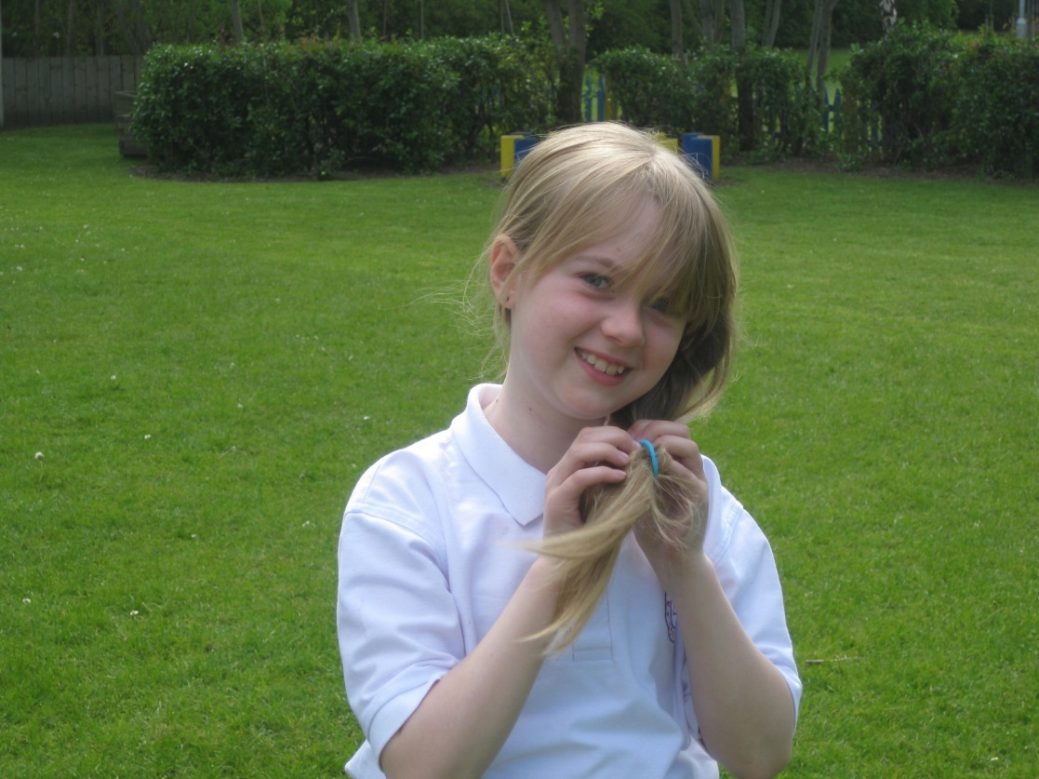

Slide 43
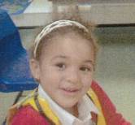
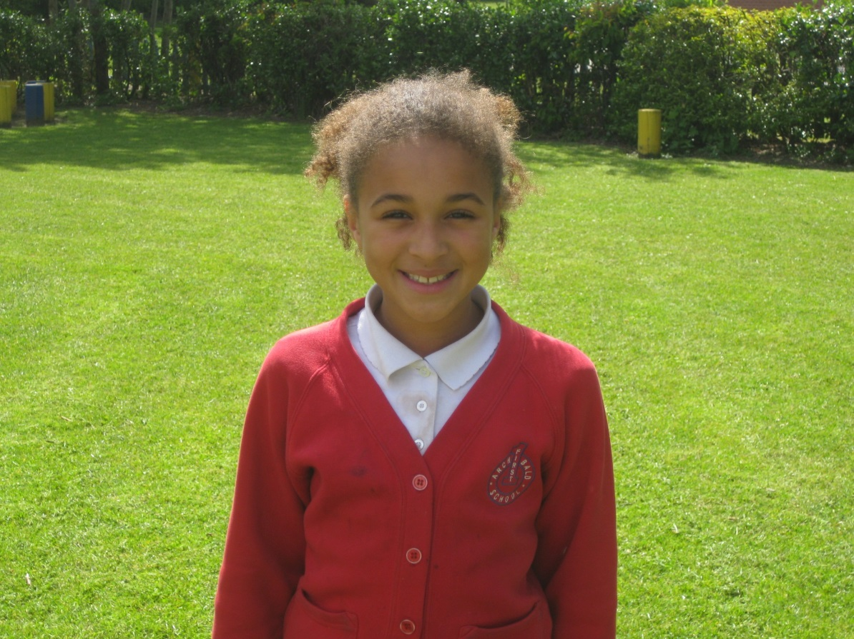

Slide 44
My favourite memory of Archibald
Is when we went to hawkirst and I done absailing and I was scared but it was really easy and than I was still scared.

Slide 45
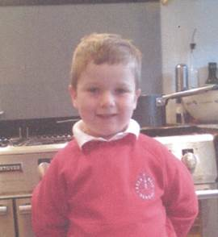
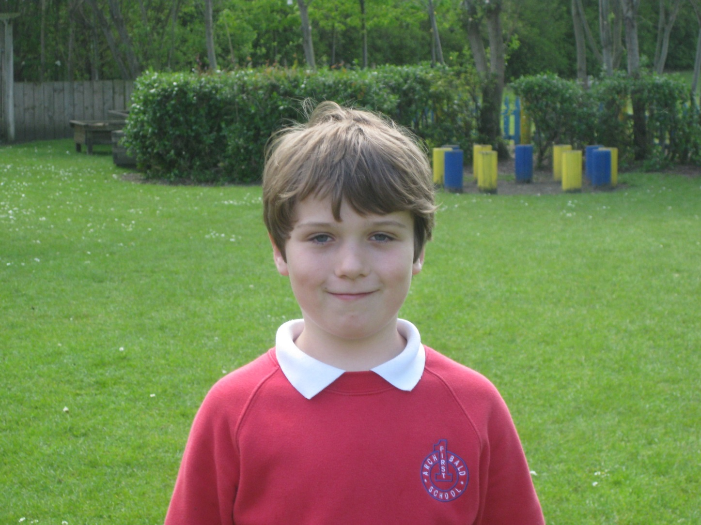

Slide 46
My favourite memory of Archibald
Was when I met all my friends in reception.

Slide 47
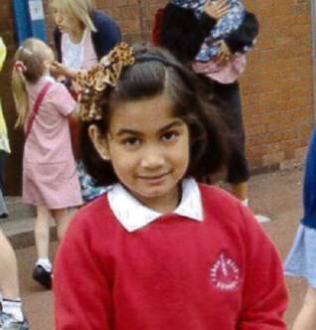
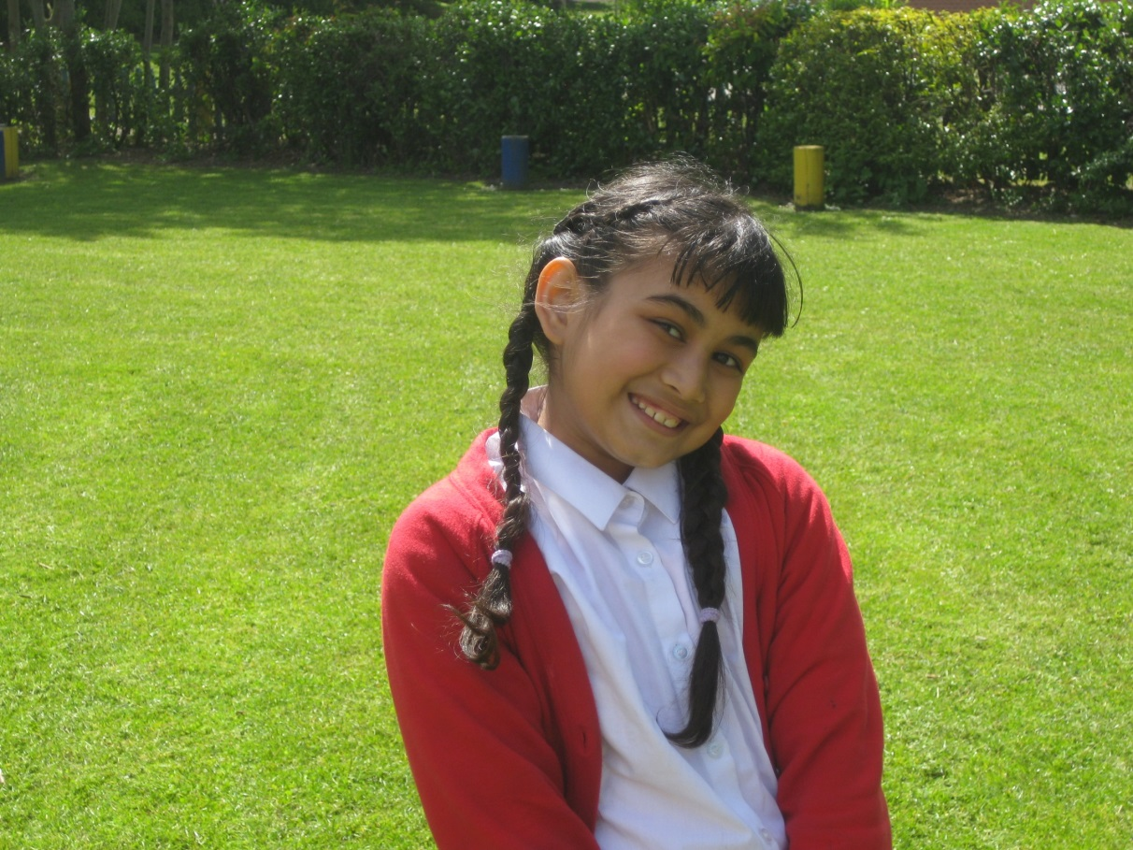

Slide 48
My favourite memory of archibald
My favourite memory is helping the teachers and doing a really fun production.
Tanu

Slide 49
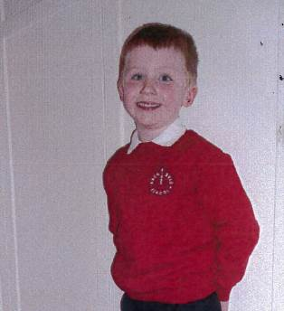
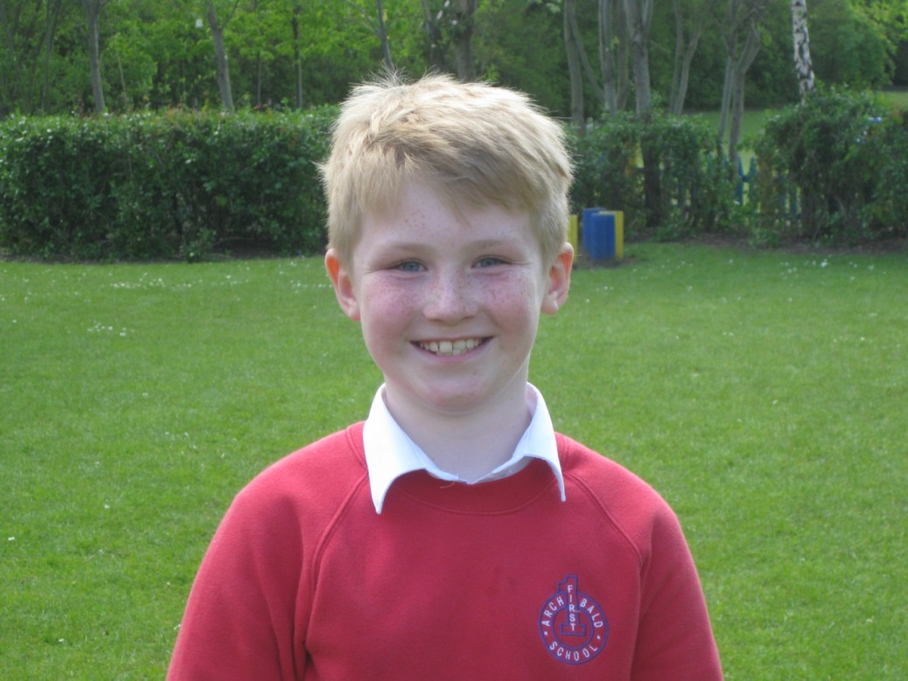

Slide 50
MY FAVOURITE MEMORY OF ARCHIBALD
My favourite memory of Archibald was when I fell in the school pond.

Slide 51
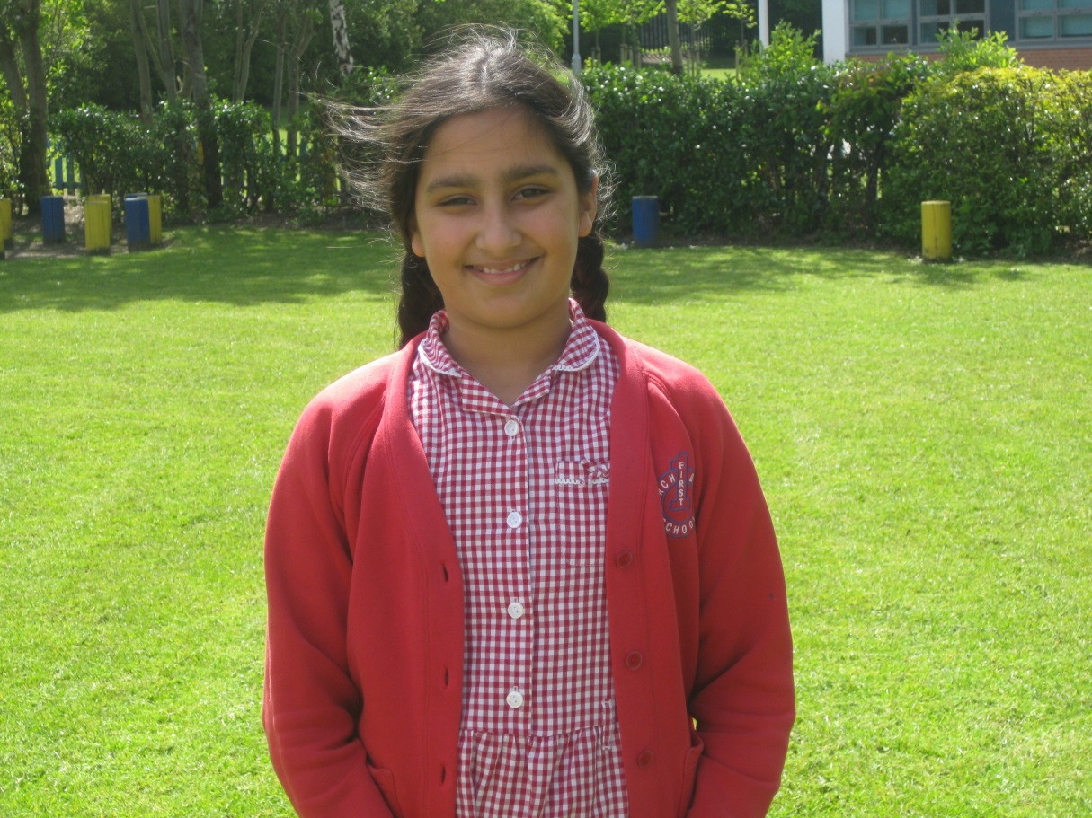

Slide 52
My favourite memory of archibald
My favourite memory of Archibald was when at lunchtime I wobbled the table and then Divine had yogurt all over her nose.

Slide 53
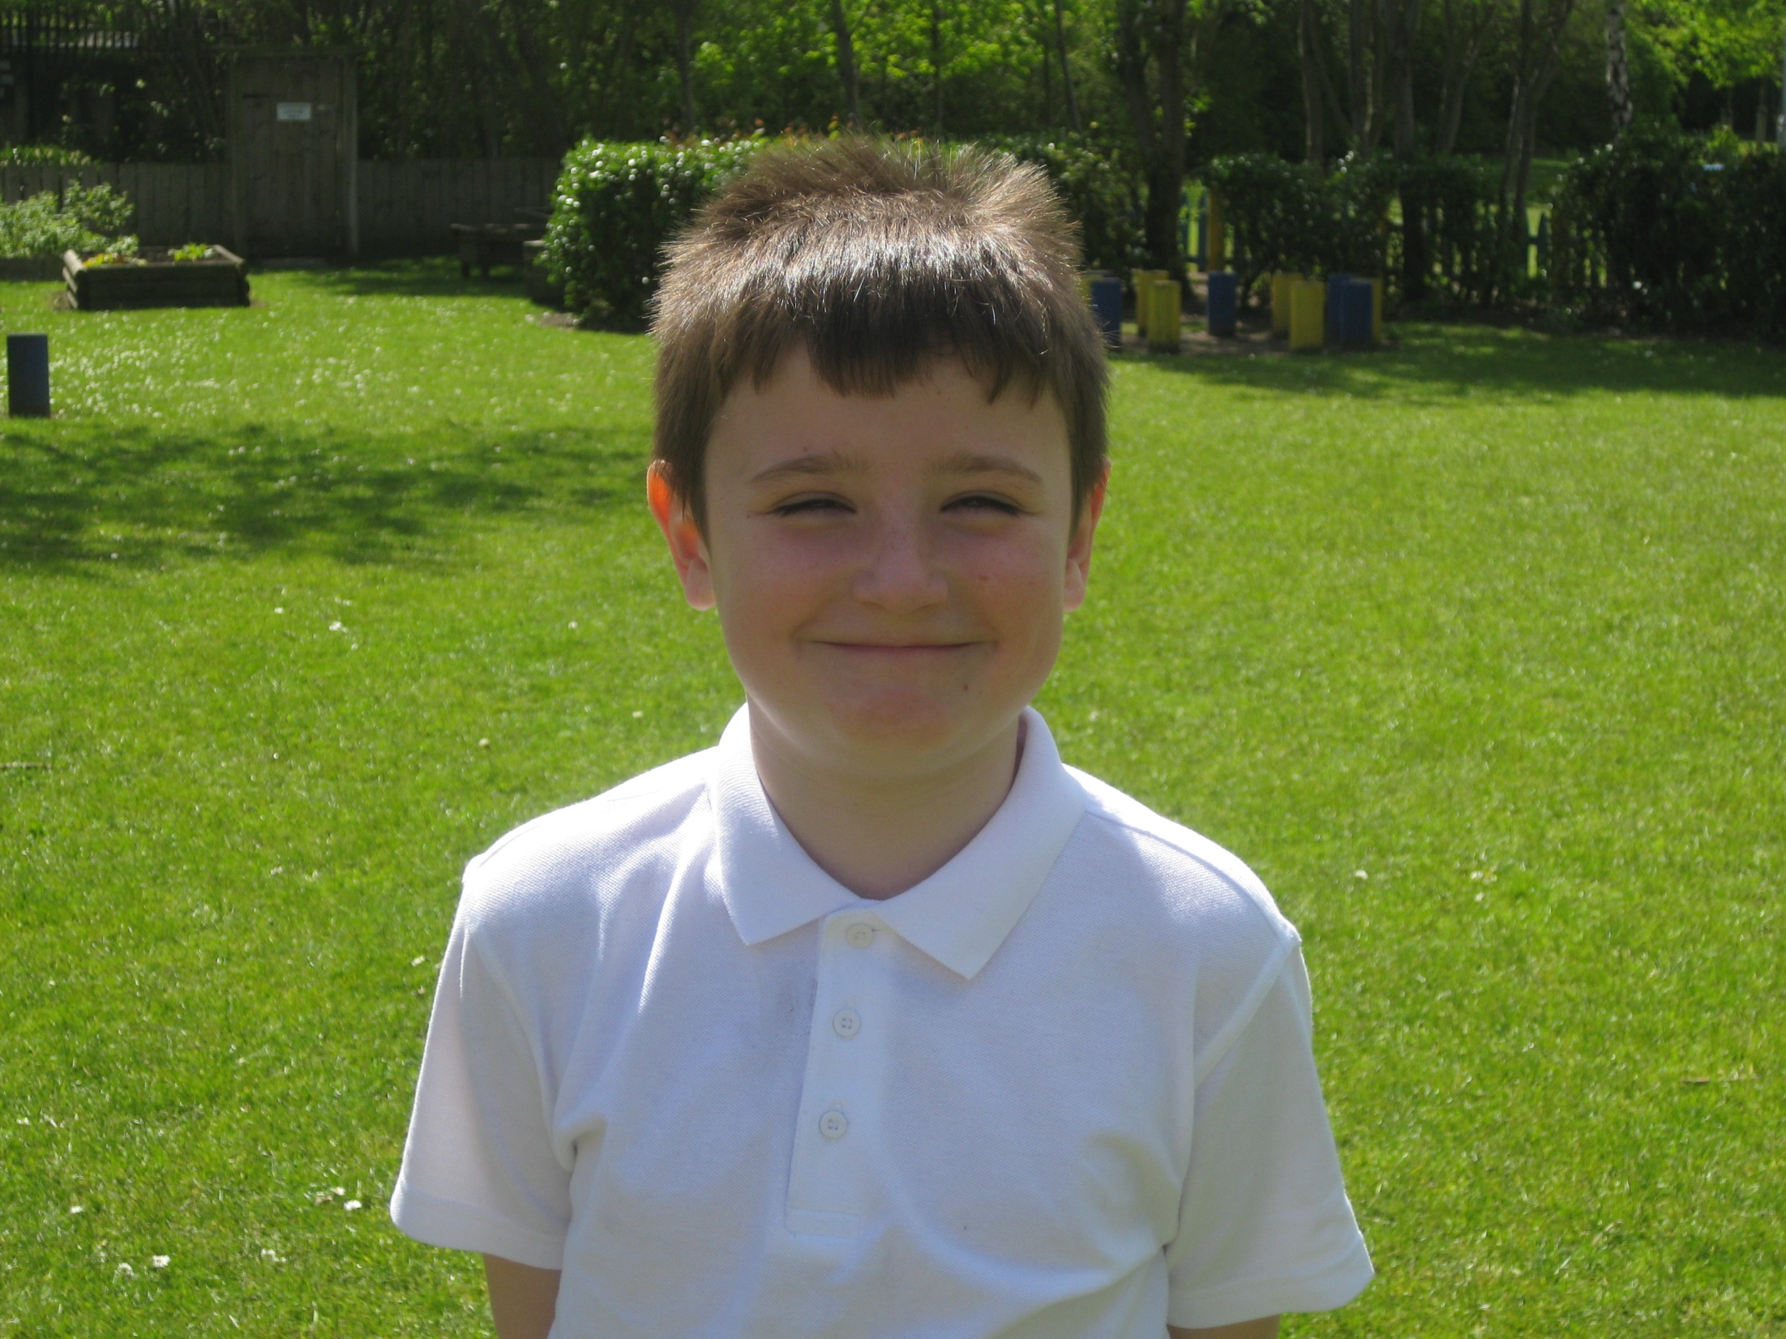

Slide 54
My favourite memory is meeting Archibald.

Slide 55
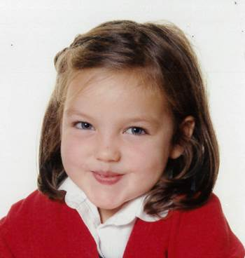

Slide 56
My favourite memory of Archibald is
When Mrs Dawson sings, does the shimmy and dances because its really
Funny! ☺

Slide 58
My favourite memory of archibald
My favourite thing about
Archibald is Hawkhirst.
Ethan

Slide 60
My favourite memory of archibald
My favourite memory was when I played Wallis and Grommet on my trumpet.

Slide 62
My favourite memory of archibald
Is elemental gamers as all my friends are in it and we get to do massive amounts of coding

Slide 64
My favorite maemory of archibald
My favourite memory of archibald is when we went to hawkirst and I was the first person to go absailing.

Slide 66
My favourite memory of Archibald
My favourite memory was going to Hawkherst and going on the zip wire.

Slide 68
My fravriot memory of archibald
Having the best X1000 TEACHERS IN THE HOLE ENTIRE UNIVERS ☺

Slide 70
My favourite memory of archibald is.
When I was a ball guest dancer in Cinderella the musical.
###

Slide 72
My favourite memory of Archibald is
My favourite is when I went to Hawkhirst.

Slide 74
My favourite memory of Archibald
When Mrs Dawson sings in the classroom.

Slide 76
My favourite memory of Archibald
My favourite memory of Archibald is going on the cycling trip from Newbern to wyln and doing art lessons

Slide 78
My favourite memory of Archibald
When we had a Christmas production rehearsal in an assembly and Mrs Dawson kept on saying queue the music to me!

Slide 80
MY FAVOURITE MEMORY OF ARCHIBALD
My favourite memory of Archibald was when I got the first goal in the semi-finals against Broadway East from the halfway line and scored. By the time I retreated to halfway everybody was jumping on me.

Slide 82
My favourite memory of archibald
My favourite memory is when we when to Hawkhirst because the Zipwire was fab!!!

Slide 84
My favourite memory of archibald
My favourite memory of Archibald was making a video gaming club with my friends called Elemental Gamers.

Slide 86
My favourite memory of Archibald
My favourite memory is when we
when to Hawkhirst.

Slide 88
My favourite memory of archibald
Was when Archibald battered reagent farm in a football match and I scored my hattrick the final score was 6- 4.
COME ON ARCHIBALD!

Slide 90
my favourite memory of Archibald
My favourite memory is when I came
to Archibald for the first time as it was great!

Slide 92
MY FAVOURITE MEMORY OF ARCHIBALD!
Was when I went to Cullercoats for the first time and went in the water!

Slide 94
My favourite memory of Archibald
My favourite memory is probably when I jumped in the lake at hawkhirst.

Slide 96
My favourite memory of archibald
My favourite memory of Archibald is when me and Sophie found a tiny frog and put it back in the school pond.

Slide 98
My favourite memory of Archibald.
My favourite memory was when Mrs Dawson sings because it makes me smile.

Slide 100
My favourite memory of archibald
My favourite memory of Archibald is when I was in year 3 and me and my best friend Divine were fighting over a stick and now it seems really funny!!!!!

Slide 102
My favourite memory of Archibald
Mine is friends having fun
and playing football

Slide 104
My favourite memory of archibald
When I built a spaceship and pretended to fly it in orange zone in Reception

Slide 106
My favourite memory of Archibald.
Is the teachers are always kind and always look after me when I am hurt.

Slide 108
My favourite memory of Archibald
Is meeting Mrs Cole and most of all having Josh as a friend and every teacher is the best teacher in the world.
Ill never forget how nice every teacher was to me.

Slide 110
My favourite memory at Archibald !
I like it when I went to Hawkist and go to do bell boating and when I jumped into the lake.

Slide 112
My favourite memory of archibald
My favourite memory of Archibald was when me Chloe, Izzy, Sophie and Maisie went to colour coats and we were playing in the sea!!!

Slide 114
My Favourite Memory Of Archibald
My favourite memory was when in was at Hawkirst
When I went on the zipwire and
All my friends were with me
By Liam

Slide 116
My favourite of archibald
Was when we went to the Centre Of Life.

Slide 118
My favourite memory of Archibald
is when I went to hawkhirst and when I did all of the cool activities like absailing!!

Slide 120
my favourite memory of Archibald
Is when mrs dorson sings

Slide 121
Leavers Assembly 2015

